Slide 1
Introduction to Computers
Course Code: GE-181
Instructor: Saba Iqbal

Slide 2
Introduction
Course:
Credit Hours: 3 (2+1)
Exams:
Mid term: After 8 weeks
Final: After 16 weeks
Attendance:
Must be above 80%

Slide 3
Evaluation:
Assignments, Quizzes and Lab : 25%
Midterm Examination : 30%
End Semester Exam : 45%

Slide 4
Contact Detail:
Email:
Saba.iqbal@uow.edu.pk

Slide 5
Textbook and Reference Books
“Computer Fundamental by PK. Sinha
Introduction to Computers, Peter Norton, sixth edition

Slide 6
Learning Objectives
In this chapter you will learn about:
Computer
Data processing
Characteristic features of computers
Computers’ evolution
Computer generations
Types of computer

Slide 7
Computer
The word computer comes from the word “compute”, which means, “to calculate”
So, a computer is an electronic device that can perform arithmetic operations at high speed
A computer is also called a data processor because it can store, process, and retrieve data whenever desired

Slide 8
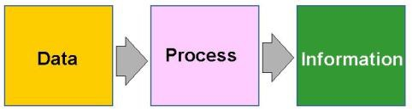
Data Processing
Data processing is a process of converting raw facts or data into a meaningful information.
Data: Data is raw material used as input
Processing: Processed by a suitable or selected processing method.
Information: The processed data is delivered in the form of information

Slide 9
Characteristics of Computers
Speed- Performs data processing jobs very fast, usually measured in microseconds, nanoseconds and picoseconds.
Accuracy- Computer accuracy is consistently high, and the accuracy depends upon its design.
Efficiency- Computer is free from monotony, tiredness, and lack of concentration. It can continuously work for hours without creating any error.
Versatility- Versatility refers to the capability of a computer to perform different kinds of works with same accuracy and efficiency. One moment it helps the user to take hard copy the same time it supports the same user to browse the internet and the same user can play the game for entertainment.

Slide 10
Characteristics of Computers
Reliability- A computer is reliable as it gives consistent result for similar set of data i.e., if we give same set of input any number of times, we will get the same result.
Automation- Computer performs all the tasks automatically i.e., it performs tasks without manual intervention.
Capacity-Computer can store and recall any amount of information because of its secondary storage capability. It forgets or looses certain information only when it is asked to do so

Slide 11
Evolution of Computers
1642: Blaise Pascal invented “Mechanical Adding Machine”
1671: Baron Gottfried invented “Calculator” for multiplication
1880: “Keyboard machines” designed in USA
1880: Herman Hollerith invented “punched cards” for input media & is used till late 70s

Slide 12
Evolution of Computers (Cont...)
Charles Babbage is the father of modern digital computers
He designed “Difference Engine” in 1822
He designed a fully automatic analytical engine in 1842 for performing basic arithmetic functions
Established several principles that are fundamental to the design of any digital computer
Notes:
The Difference Engine was a large calculator designed to compute polynomial functions, while the Analytical Engine was a more advanced general-purpose computer that used punched cards for input and output, and was capable of performing a wide range of calculations.

Slide 13
Some Well Known Early Computers
MARK I computer (1937 - 1944)
Electro-mechanical calculating device, 50 ft-long x 8 ft-high
Add: 0.3 sec, mul:4.5 sec
Atanasoff-Berry Computer (ABC) (1939-1942)
Electronic machine to solve some mathematical functions
ENIAC (1943-1946)
All electronic computer 20x40 sqft, add: 200 us, mul: 2000us
EDVAC (1946-52)
Used stored program concept, instructions & data stored in binary form
UNIVAC I (1951)
First digital computer
Notes:
Electronic Numerical Integrator and Computer) was the first programmable, electronic, general-purpose digital computer, completed in 1945
EDVAC (Electronic Discrete Variable Automatic Computer) was one of the earliest electronic computers
The UNIVAC I (Universal Automatic Computer I) was the first general-purpose electronic digital computer design for business application

Slide 14
Computer Generations
“Generation” in computer talk is a step-in technology. It provides a framework for the growth of computer industry
Originally it was used to distinguish between various hardware technologies, but now it has been extended to include both hardware and software
Till today, there are five computer generations

Slide 15
First Generation (1940-1956)
In first generation vacuum tube technology is used
A vacuum tube is a glass device
It could control and amplify electronic signals
First generation computers are : Mark-1, ENIAC, EDSAC, EDVAC, UNIVAC-1 etc.
The machine language was used in first generation language.

Slide 16
First Generation (1940-1956)
Pros
Fastest computers of their time, able to perform calculations in milliseconds
They are programmed using machine language
Due to vacuum tubes electronic digital computers were introduced
Cons
It had slow performance
It occupied large size due to the use of vacuum tubes.
It had a poor storage capacity.
It consumed a lot of electricity.
Generated a lot of heat and air-conditioning was required.

Slide 17
Second Generation (1956-1963)
It uses transistors technology
Transistors is an electronic component.
It makes computers smaller, faster, more energy efficient and reliable than vacuum tube.
It was invented in 1948 at Bells Lab.
And they advanced from binary to assembly languages
Second generation computers are: IBM 7074 series, IBM 1400 series, CDC 164 etc.

Slide 18
Second Generation (1956-1963)
Pros
Batch operating system
Faster and smaller in size
Reliable and energy efficient than the previous generation
Less costly than the previous generation
Cons
Air conditioning still required
Use only for special purposes
Constant maintenance required

Slide 19
Third Generation (1964-1971)
Used Integrated Circuit (IC) technology
Large capacity disks and magnetic tapes
High level languages were commonly used.
Third generation computers are: IBM System / 360 & IBM 370, DEC , PDP-8, UNIVAC 1108, UNIVAC 9000 etc.

Slide 20
Third Generation (1964-1971)
Pros
Supports time-sharing OS
Faster, smaller, more reliable and cheaper than the previous generations
Easy to access, more storage capacity, upgraded easily
Lower heat generated
Many input/output devices were introduced such as mouse and keyboard etc.
Cons
Highly sophisticated technology required for the manufacturing of IC chips.

Slide 21
Fourth Generation (1971-Present)
ICs with Very Large-Scale Integration (VLSI) technology
Microprocessors are used as CPU.
The microprocessor is a computer processing circuitry on a single chip.
Semiconductor memory is used because of increase in internal storage
Object-oriented high-level programs supported
Examples: Apple II, VAX 9000, CRAY 1 (super computers)
Notes:
Today, microprocessor is also used in many electronic devices such as microwave oven, wristwatches etc.

Slide 22
Fourth Generation (1971-Present)
Pros
Multiprocessing & distributed OS
Small & easy to use; hand-held computers have evolved
No external cooling required & affordable
This generation saw the development of networks and the internet
Cons
Highly sophisticated technology required for the manufacturing of microprocessor.

Slide 23
Fifth Generation (Present and beyond)
It is based on artificial intelligence and Nano technology
Large capacity hard disk
Some applications such as voice recognition are being used today.
These computers have capabilities of parallel processing and super conductors are used.
Powerful servers, Internet, Cluster computing
Pros
Powerful, cheap, reliable and easy to use.
Portable and faster due to use of parallel processors and Super Large Scale Integrated Circuits.
Rapid software development is possible.

Slide 24
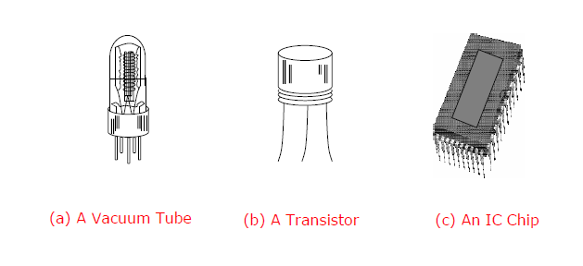
Electronic Devices Used in Computers of Different Generations

Slide 25
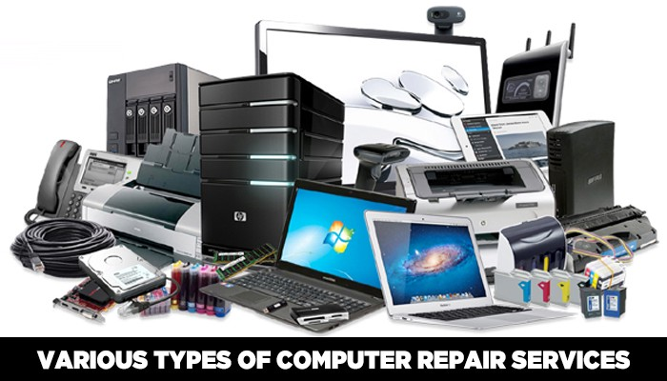
Classification of Computer
Based on work
On the basis of functionality or the way in which computers perform the tasks are classified into the following types:
Types of Computer
Analog
Digital
Hybrid

Slide 26
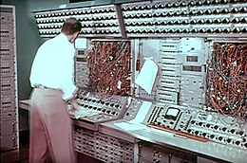
Analog Computers
The word “analog” means continuously varying in quantity.
The analog computers accept input data in continues form and output is obtained in the form of graphs.
It means that these computers accept input and give output in the form of analog signals.
The output is measured on a scale. The voltage, current, sound, speed, temperature, pressure etc. values are example of analog data.
These values continuously increase or decrease. The analog computers are used to measure the continuous values.
Examples: Thermometer, Analog clock, Speedometer, Tire pressure Gauge.

Slide 27
Characteristics of Analog Computers
The analog computers are usually built for special purpose.
They have very high-speed computing elements used to process physical quantities.
These computers have low memory size and have fewer functions
These are very fast in processing
These computers are used in industrial units to control various processes.
They are also used in different fields of engineering and medical.

Slide 28
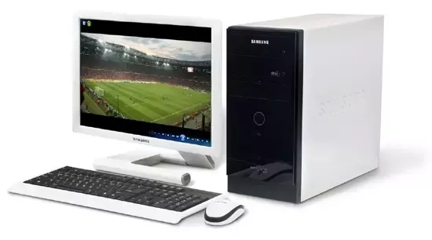
Digital Computer
The word “digital” means discrete.
It refers to binary system, which consists of only two digits, i.e. 0 and1.
Digital data consists of binary data represented by OFF(low) and ON(high) electrical pulses.
These pulses are increase and decreased in discontinuous form rather than in continuous form.
In digital computers, quantities are counted rather than measured.
A digital computer represents the data in digital signals 0 and 1 and then processes it using arithmetic and logical operations

Slide 29
Digital Computer
Examples:
Examples of digital computers are IBM PC, Apple Macintosh computers etc.
Other Digital devices are Calculators, Digital watches and digital thermometers etc.

Slide 30
Characteristics of Digital Computer
These computers are easy to use.
Gives accurate result.
Having high speed of data processing.
Can store large amount of data
Easy to program and general purpose in use.
Consume low energy.

Slide 31
Hybrid Computer
A hybrid computers have best combined features of both analog and digital computers.
These computers contain both the digital and analog components.
In hybrid computers, the user can process both the continuous(analog) and discrete(digital)data.
Hybrid computers for example are used for scientific calculations. In hospitals, these are used to watch patient’s health condition in ICU, also used in defense and radar systems.
Example: Notebook, Laptop etc.

Slide 32
Hybrid Computer
These are special purpose computers.
In hospitals, these are used to watch patient’s health condition in ICU.
These are also used in defense and radar systems, spaceships etc.
Example:
ECG machine and other devices used in ICU.
Devices used in petrol pump

Slide 33
Characteristics of Hybrid Computers
These computers are reliable and provide accurate results.
These computers are fast and speedy.
They provide output both in numeric and in graphic form.

Slide 34
Classification of Computer
Computers are being manufactured in different sizes, data processing speeds etc.
Computers are classified according to their data processing speed, amount of data that they can hold and price.
Generally, a computer with high processing speed and large internal storage is called a big comp

Slide 35
Classification of Computer
Based on size
Depending upon their speed and memory size, computers are classified into following four main groups.
Super Computers
Mainframe Computers
Mini Computers
Micro Computers

Slide 36
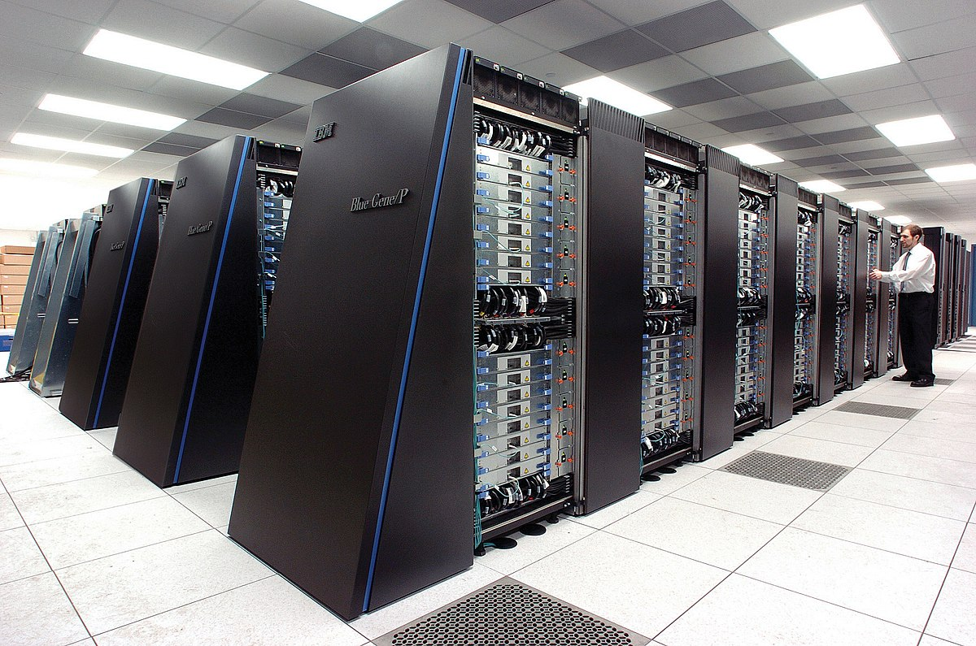
Super Computers

Slide 37
Super Computer
Super computer is the most powerful and fastest, and also very expensive.
It was developed in 1980s.
It is used to process large amount of data and to solve the complicated scientific problems.
It can perform more than one trillions calculations per second.
It has large number of processors connected in parallel. So, parallel processing is done in this computer.
In a single super computer thousands of users can be connected at the same time and the super computer handles the work of each user separately.

Slide 38
Applications of Super Computer
Super computers are mainly used for
Weather forecasting
Nuclear energy research
Aircraft design
Automotive design
Online banking
To control industrial units.
The super computers are used in large organizations, research laboratories, aerospace centers, large industrial units etc.
Nuclear scientists use super computers to create and analyze models of nuclear fission and fusions, predicting the actions and reactions of millions of atoms they interact.

Slide 39
Examples of Super Computer
Examples of super computer are:
CRAY-1
CRAY-2
Control data CYBER 205
ETA-10 etc.

Slide 40
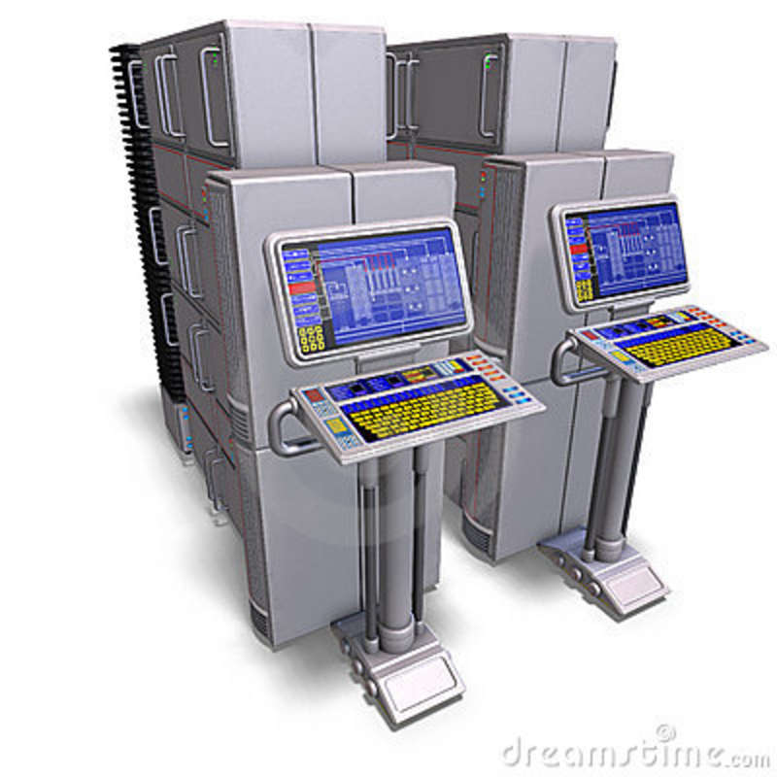
Mainframe Computer

Slide 41
Mainframe Computer
Mainframe computer is the large sized computer.
It is general purpose computer that is designed to process large amount of data with very high speed.
It accepts large amount of data form different terminals and multiple users and process them at same time.
More than 100 users are allowed to work in this system.
It is applicable for large organization with multi-users.
For example: large business organization, department of examinations, industries and defense to process data of complex nature.
It uses several CPU for data processing

Slide 42
Application of Mainframe Computer
Credit card processing
Bank Account Management
Marketing
Business data processing in large organization
Air traffic control system
Industrial design

Slide 43
Example of Mainframe Computer
IBM S/390
IBM S/709
ICL 39
CDC 6600
Etc.

Slide 44
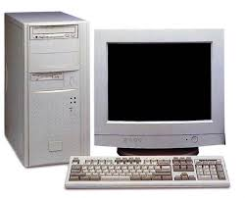
Micro Computer

Slide 45
Micro Computer
Most popular general purpose computers which are mostly used on day to day work are microcomputers.
These are popular as Home PC or Personal Computer (PC) because these are single user computers and mostly used for personal use and application.
Desktop computers, laptops, gaming consoles, sound and navigation system of a car, personal digital assistant (PDA), tablets and smartphones are all types of microcomputers.
These support many higher level application cost and easy in operation.

Slide 46
Micro Computer
Well-known manufactures of microcomputers are
Dell
Apple
Samsung
Sony
Toshiba
HP
Lenovo

Slide 47
Characteristics of Micro Computer
Fast speed and accuracy
Small in size
Easy to operate
Easy to move
Cheaper
We can use desktop computers as a single user and multi-user environment

Slide 48
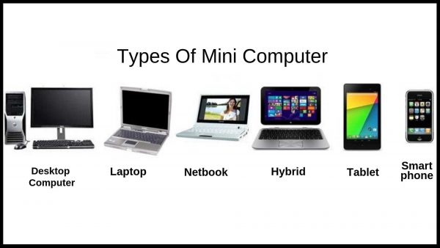
Mini Computer

Slide 49
Mini Computer
Mini computers are medium sized computer.
The capabilities of minicomputer are between mainframe and personal computer
So, these are popular as middle ranged computer.
It is costlier than microcomputer.

Slide 50
Application of Mini Computer
It is used in university, middle range business organizations to process complex data.
It is also used in scientific research
Instrumentation system
Engineering analysis
Industrial process monitoring and control etc.

Slide 51
Examples of Mini Computer
PDP-11
VAX
HP 3000
Prime 9755 etc.
7500 MAGNUM

Slide 52
Q/A

